Slide 1
Information Visualization Final Presentation
World Happiness Report 2015 - 2023
Bhavana Devulapally (BHD30)
Source Code: https://colab.research.google.com/drive/1tNUM2eyOofeMI5wQK9Kq7WVY8swcPCWC#scrollTo=V0hldZfq1um-

Slide 2
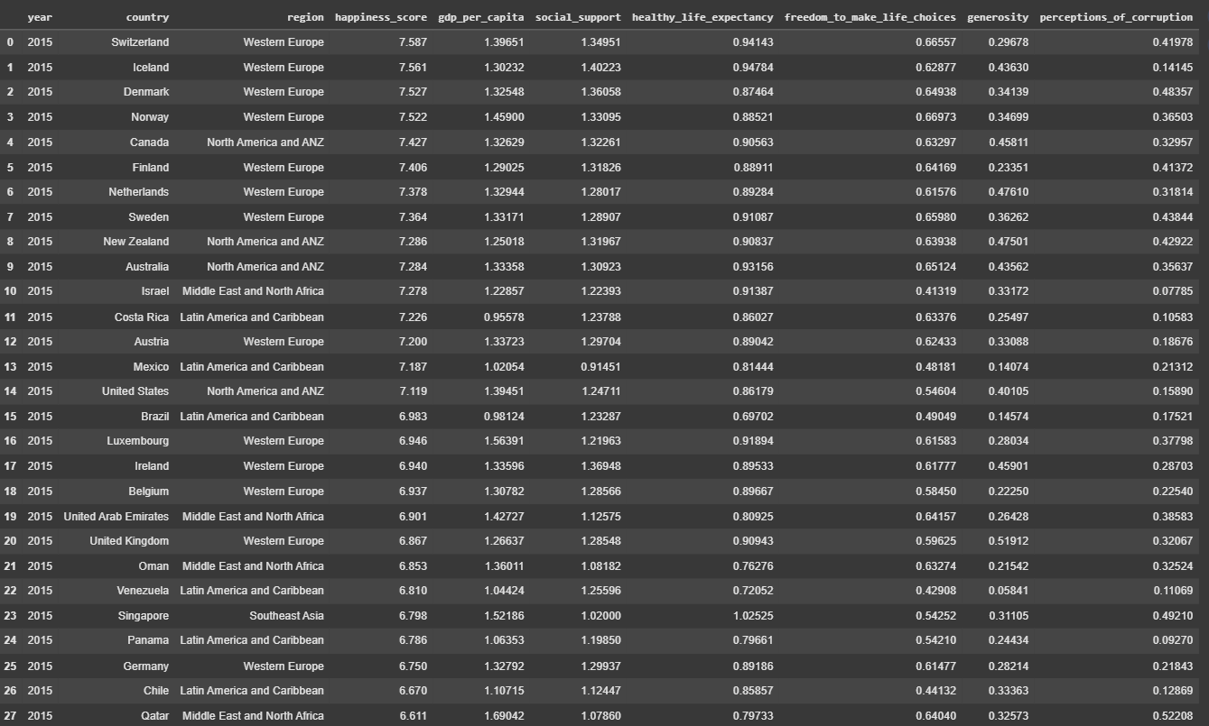
Overview of the Data – World Happiness Report 2015 -2023

Slide 3
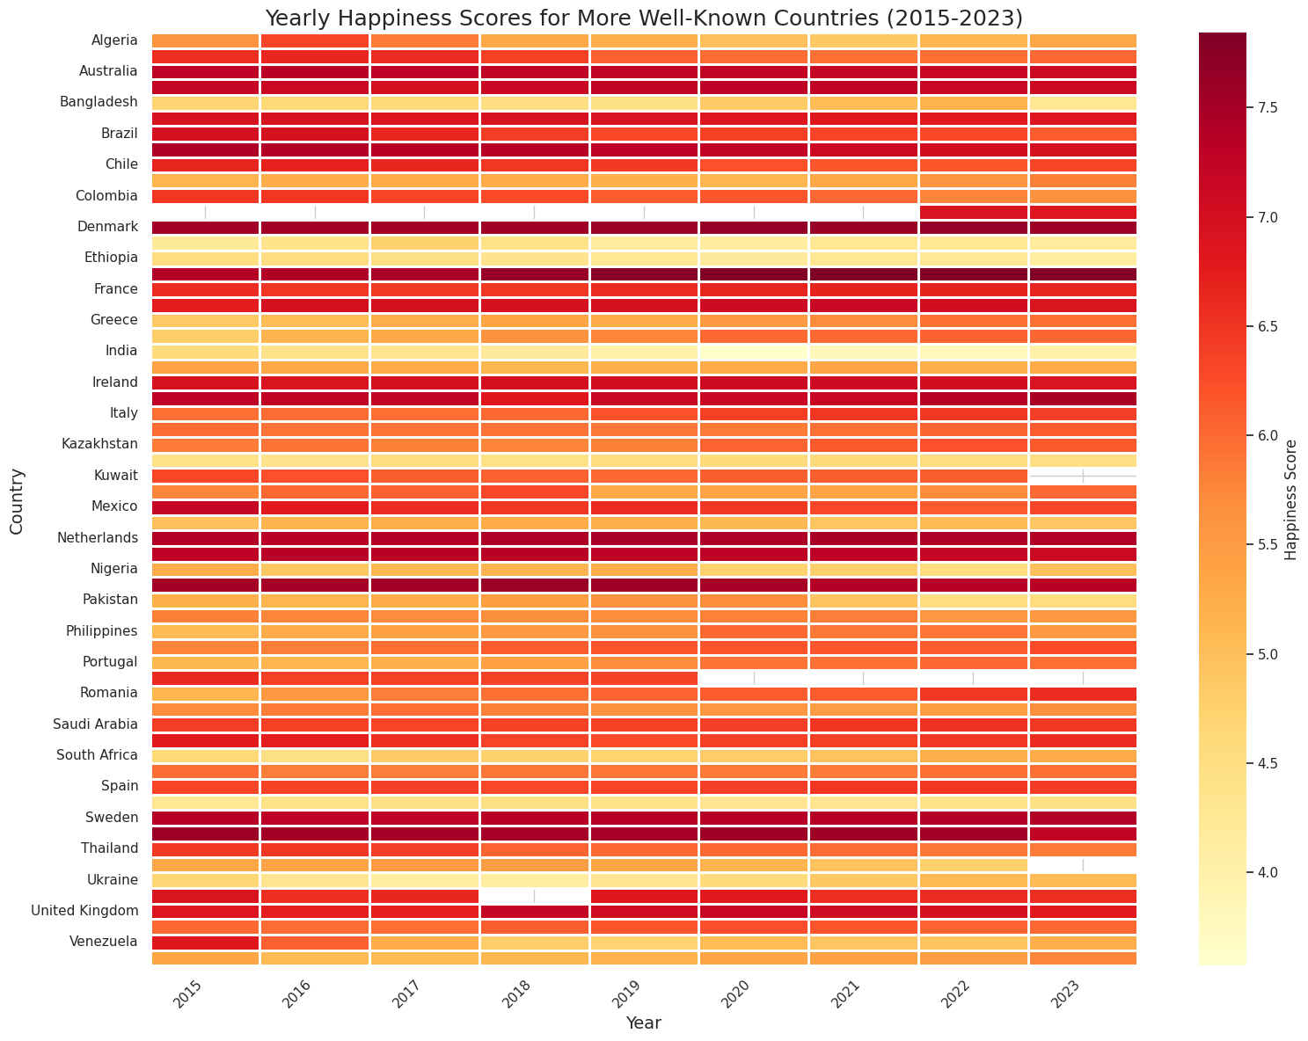
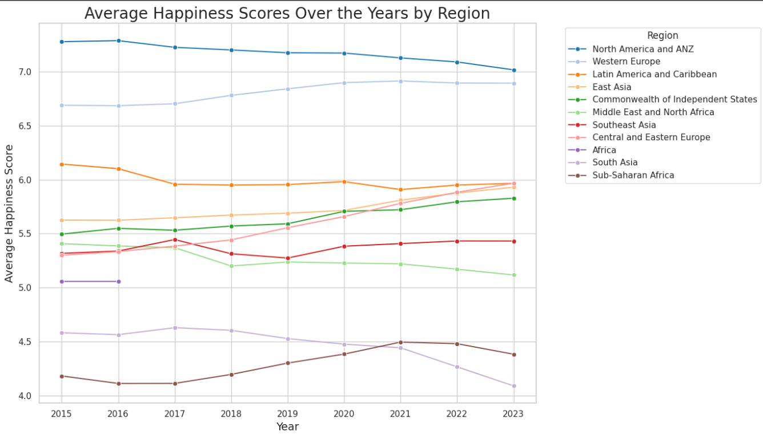
Average Happiness Scores Over the Years by Region

Slide 4
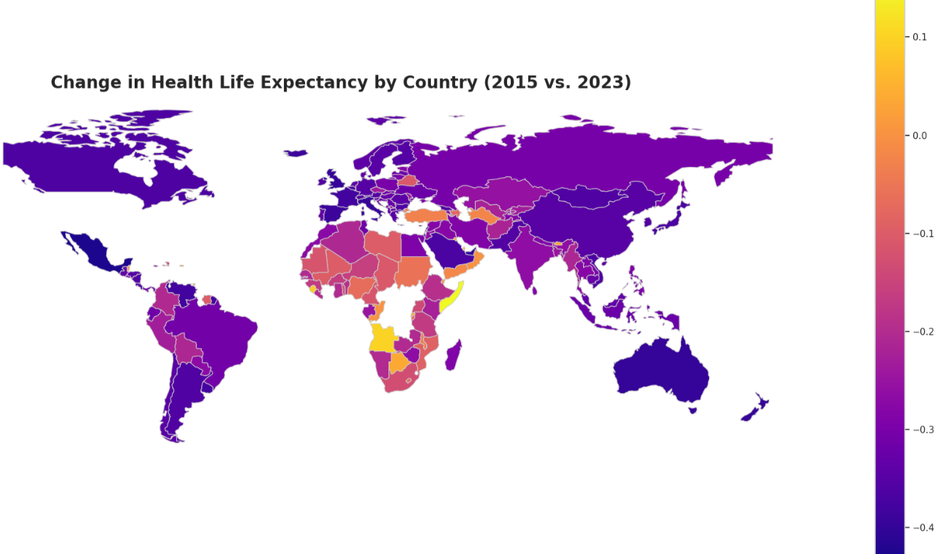
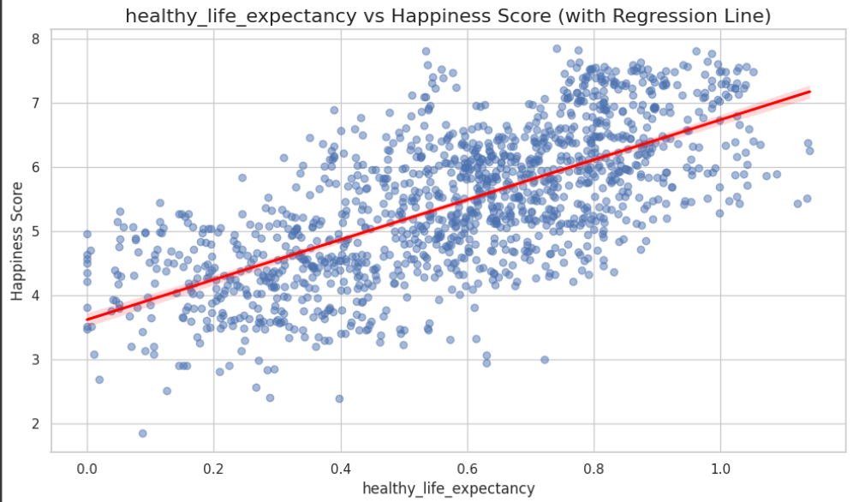
Change in Health Life Expectancy by Country (2015 vs. 2023)
Impact of Health Life Expectancy wrt Happiness Score

Slide 5
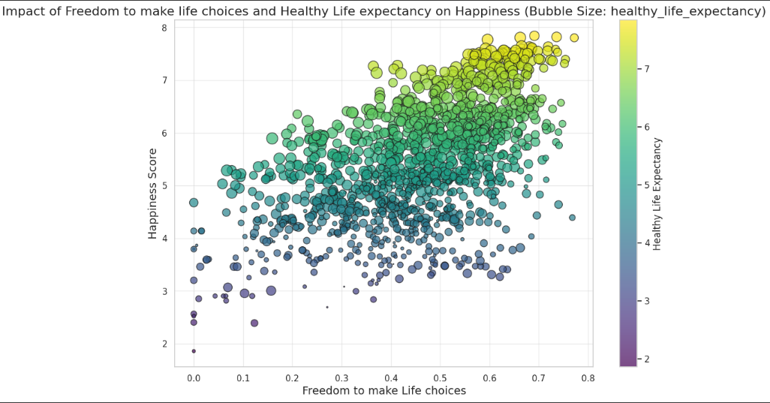
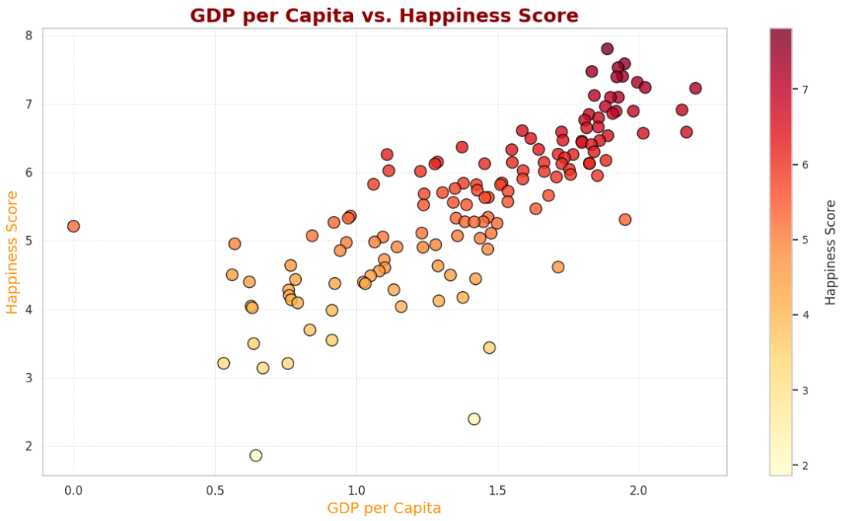

Slide 6
